Slide 1


Object Oriented Programming with Java
By
Puneethraj K
Dept. of Computer Science

Slide 2
Unit – I

Slide 3
The Origins of Java
Java is a widely-used programming language that was created by James Gosling and his team at Sun Microsystems in the early 1990s.
It evolved into a comprehensive and robust language for general computing applications.
Java is known for its "write once, run anywhere" capability, allowing developers to write code that can run on any device that supports Java without the need for recompilation.
It is portable and cross platform language.

Slide 4
Java’s Contribution to the Internet
Applets
Security
One of Java's major contributions to the internet is its support for applets, which are small programs that can be embedded in web pages to provide interactive features. This allowed for dynamic and engaging web content, paving the way for modern web applications and interactive websites.
A normal program that is downloaded may contain Viruses, Trojan horses or other harmful code which can gain an unauthorized access to the recourses. To download and execute applets safely some protection mechanism is needed. This 2 protection is achieved by confining an applet to the Java execution environment and not allowing it access to the other parts of the computer.

Slide 5
Java’s Contribution to the Internet
Portability
Portability is a major aspect of the Internet because there are different types of computers and operating systems connected to it. A Java program need to be executed on any computer connected to the Internet. It is not practical to have different versions of applet for different computers. The same code must work in all computers.

Slide 6
Java’s Magic: The Bytecode
1
Platform Independence
2
Enhanced Security
Java's bytecode allows programs to be executed on any platform that has a Java Virtual Machine (JVM). This "write once, run anywhere" capability is made possible by the JVM, which interprets the bytecode into machine code specific to the underlying hardware and operating system.
The use of bytecode adds a layer of security by preventing direct execution of machine code, thereby reducing the risk of security vulnerabilities and malicious attacks. This has been a key factor in Java's popularity for building secure applications.

Slide 7
Java’s Magic: The Bytecode
3
Optimized Performance
Bytecode allows for dynamic optimizations at runtime, enabling efficient execution of Java programs. This contributes to Java's performance across different platforms, making it a preferred choice for performance-critical applications.

Slide 8
Java’s Magic: The Bytecode
Java bytecode is the instruction set for the Java Virtual Machine. As soon as a java program is compiled, java bytecode is generated. In more apt terms, java bytecode is the machine code in the form of a .class file. With the help of java bytecode we achieve platform independence in java.

Slide 9
Java’s Magic: The Bytecode
When we write a program in Java, firstly, the compiler compiles that program and a bytecode is generated for that piece of code. When we wish to run this .class file on any other platform, we can do so. After the first compilation, the bytecode generated is now run by the Java Virtual Machine and not the processor in consideration. This essentially means that we only need to have basic java installation on any platforms that we want to run our code on. Resources required to run the bytecode are made available by theJava Virtual Machine, which calls the processor to allocate the required resources. JVM's are stack-based so they stack implementation to read the codes.

Slide 10
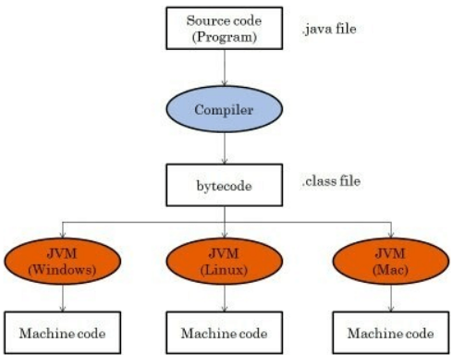
Java’s Magic: The Bytecode

Slide 11
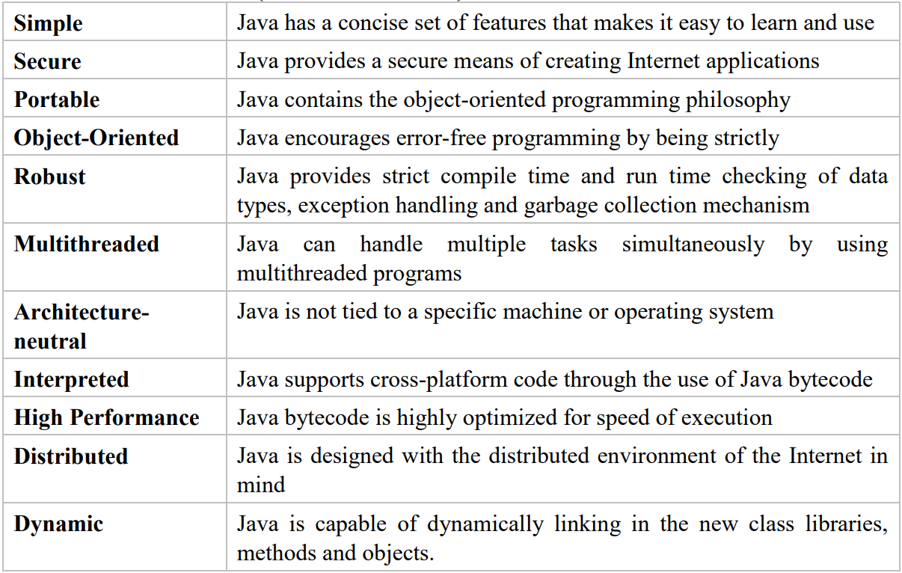
The Java Buzzwords (Features of Java)

Slide 12



Object-Oriented Programming
Encapsulation
Encapsulation in Java is the process by which data (variables) and the code that acts upon them (methods) are integrated as a single unit. By encapsulating a class's variables, other classes cannot access them, and only the methods of the class can access them.
Inheritance
By allowing a class to inherit commonly used state and behavior from other classes, Java promotes code reusability and helps create hierarchical relationships between classes.
Polymorphism
Polymorphism is considered one of the important features of Object-Oriented Programming. Polymorphism allows us to perform a single action in different ways. In other words, polymorphism allows you to define one interface and have multiple implementations. The word “poly” means many and “morphs” means forms, So it means many forms.

Slide 13
A Simple Java Program
public class HelloWorld {
public static void main(String[] args) {
System.out.println("Hello, World!");
}
}

Slide 14
A Simple Java Program
The Java compiler requires that a source file use the .java extension. So the name of the above program must be HelloWorld.java.
In Java, all code must reside inside a class. The name if the main class should match the name of the file that holds the program.
To compile the program, execute the compiler, javac, specifying the name of the source file on the command line as
javac HelloWorld.java

Slide 15
A Simple Java Program
All Java applications begin execution by calling main() method.
The public keyword is an access modifier which determines how the program can access the members of the class. If the keyword is public, then it can be accessed by code outside the class in which it is declared.

Slide 16
A Simple Java Program
The keyword static allows main() to be called before an object of the class has been created.
This is necessary because main() is called by the JVM before any objects are made.
The keyword void tells the compiler main() does not return any value.

Slide 17
A Simple Java Program
In main() there is only one parameter args[] of type array of String.
In this case args[] receives any command-line arguments present when the program is executed.
System.out.println(“This is my First Java Program”);

Slide 18
A Simple Java Program
println() is the method used to display output, System is a predefined class that provides access to the system and out is the output stream connected to the console.
Thus System.out is an object that encapsulates console output.

Slide 19
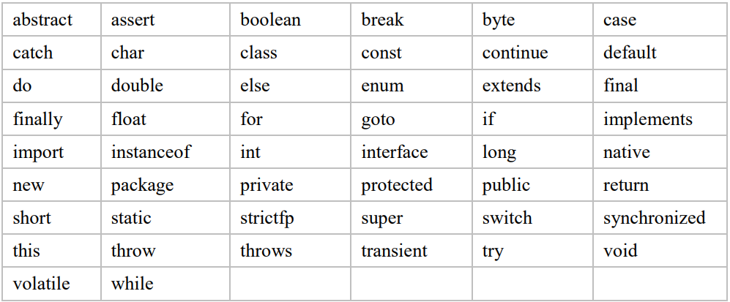
Java Keywords
Fifty keywords are currently defined in Java. Keywords cannot be used as names for variable, class or method.

Slide 20
Identifiers in Java
An identifier is a name given to a method, a variable or any other user-defined item.
Identifier can be from one to several character long.
It may start with an alphabet, an underscore or a dollar sign
It cannot contain space or any other special character
Keywords cannot be used as identifiers. Names of any standard methods like println cannot be used as identifier.

Slide 21
Java’s Primitive Data Types
Primitive Type
Description
boolean
Stores true or false values
byte
8-bit integer
char
16-bit Unicode character
short
16-bit integer
int
32-bit integer
long
64-bit integer
float
32-bit floating point
double
64-bit floating point

Slide 22
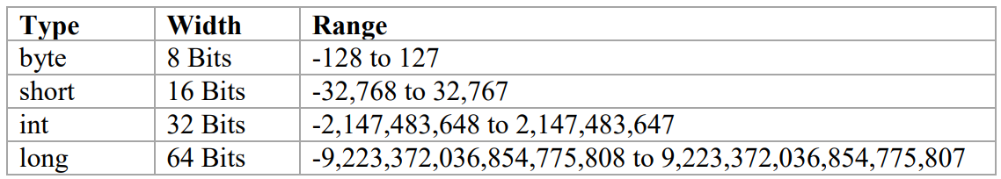
Java’s Primitive Data Types
Integer Values:
Java defines four integer types: byte, short, int and long. The range allows both positive and negative values.

Slide 23
Java’s Primitive Data Types
Floating Point Values:
Floating Point Types: Floating-point types can represent numbers that have fractional components.
There are two kinds of floating-point type float and double which single- and double-precision numbers respectively are.
Type float is 32-bit wide and double is 64-bit wide.
Double is most commonly used because all math functions in Java’s class library use double values.

Slide 24
Java’s Primitive Data Types
Characters:
In Java, char is an unsigned 16-bit type having a range of 0 to 65,536.
A character variable can be assigned value by enclosing the character in single quotes.
For example, to assign value X to variable ch we use the following Java statement:
char ch=’X’;

Slide 25
Java’s Primitive Data Types
Boolean Type:
The Boolean type represents true/false values.
boolean b= true;

Slide 26
Literals
Literals refer to fixed values. For example -100, 999 are valid integer literals. By default integer literals are of type int. If long integers are to be used, an L or l is to be appended. Example: 12L.
By default, floating point numbers are of type double. To specify a float literal, F or f is to be appended to the constant. Example: 10.3 is of type double and 10.3F is of type float.

Slide 27
Literals
A hexadecimal literal must begin with 0x or 0X where as an octal literal always begins with 0.
Example hex = 0X45C; oct = 011;.
Java also supports sting literals. A string is a set of characters enclosed within double quotes.
For example “Good Morning”.

Slide 28
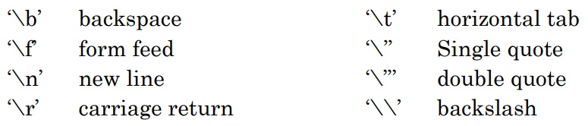
Escape Sequences:
Java supports some special backslash character constants that are used in output methods.

Slide 29
Variables
Variables are the names of storage locations. After designing suitable variable names, we must declare them to the compiler. Declaration does three things.
It tells the compiler what the variable name is.
It specifies what type of data the variable will hold.
The place of declaration decides the scope of the variable
A variable must be declared before it is used in the program. This is necessary because the compiler must know what type of data it contains.
Ex: int count; float height; boolean flag;

Slide 30
Dynamic Initialization
Java allows variables to be initialized dynamically, using any expression valid at the time the variable is declared.
Example:
class DynInit {
public static void main(String args) {
double radius=4, height=5;
double volume = 3.1416 * radius * radius * height;
// volume is initialized dynamically
system.out.println(“Volume = ” +volume); } }
In the above program, there are three local variables namely height, radius and volume. The first two are initialized by a constant and the volume is initialized dynamically.

Slide 31
The Scope and Lifetime of Variables
Java allows variables to be decaled within any block.
Scope determines the visibility of objects to the other parts of the program. It also determines the lifetime of those objects.
In Java variables can be declared within any block. Variables declared inside the block are not visible to the code which is defined outside the block.

Slide 32
The Scope and Lifetime of Variables
Example:
public class ScopeExample {
public static void main(String[] args) {
int x = 10; // Local variable with method scope
if (x == 10) {
int y = 20; // Local variable with block scope System.out.println("x is " + x + " and y is " + y);
} // Variable y cannot be accessed here
System.out.println("x is " + x); }}

Slide 33
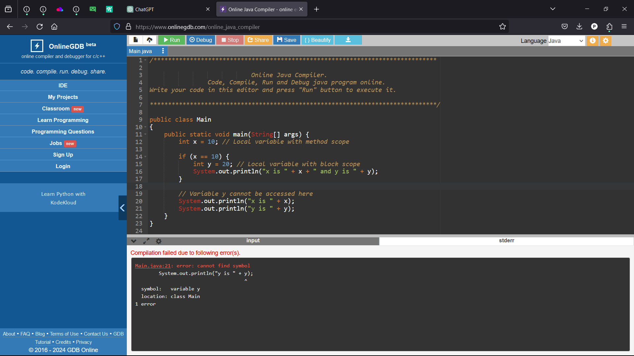
The Scope and Lifetime of Variables

Slide 34
Operators
An operator is a symbol that tells the compiler to perform a specific mathematical or logical manipulation. Java has four general classes of operators: arithmetic, bitwise, relational and logical.

Slide 35
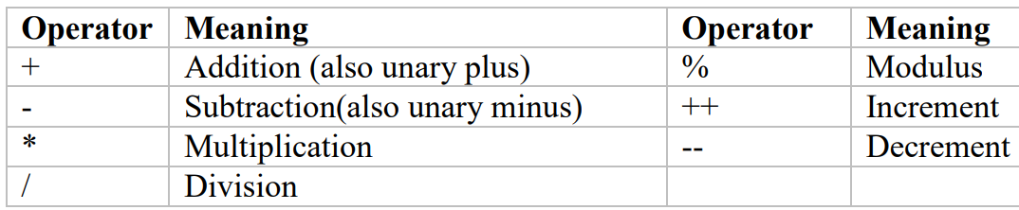
Arithmetic Operators
Example:
x = 10;
y = ++x; // In this case y becomes 11
x = 10;
y = x++; // y =10 but x = 11

Slide 36
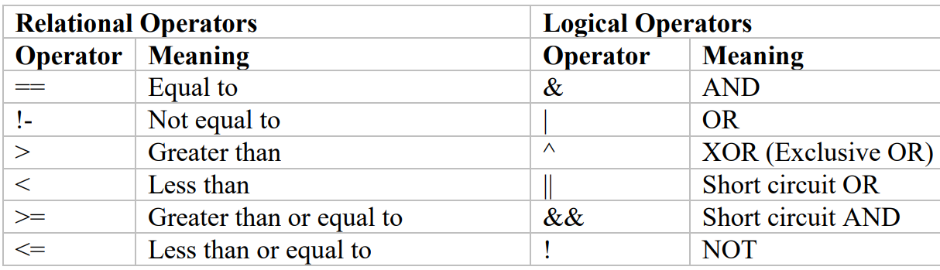
Relational and Logical Operators
Relational operators can be applied to all numeric as well as char data types. For logical operations, operands must be of type Boolean and the result of logical operation is of type Boolean.

Slide 37
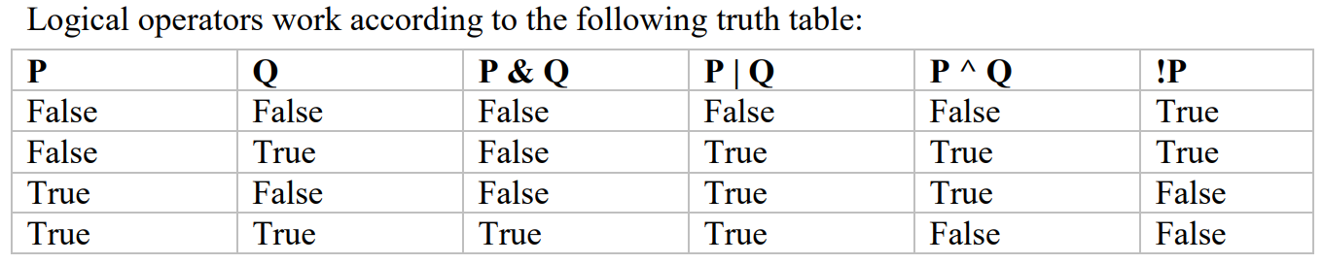
Relational and Logical Operators

Slide 38
Assignment Operators
The assignment operator is =. The general form is var=expression; the type of var must be compatible with the type of expression.
Example:
int x, y, z;
x = y = z = 100; // will set 100 to variables x, y and z

Slide 39
Shorthand Operators
An expression of the kind x=x+10;can be written as x+=10; The operator pair += tells the compiler to assign x+10 to the variable x.
+= | -= | *= | /=
%= | &= | |= | ^=

Slide 40
Type Conversion in Assignments
When compatible types are mixed in an assignment, the value of the right side is automatically converted to the type of the left side. Not all types are compatible in Java. For example, int and boolean are not compatible.

Slide 41
Type Conversion in Assignments
Example:
class TypeDemo {
public static void main(String args[]) {
long L, double D;
L=123456L;
D=L; // Automatic conversion from long to double; D=123456.0;
L=D; //Illegal. No automatic type conversion from double to long }
}

Slide 42
Casting in Compatible Types
A cast is an instruction to the compiler to convert one type into another. It has the following form: (target-type) expression; Here, target-type specifies the desired type to convert the specified expression to.

Slide 43
Casting in Compatible Types
Example:
public class ExplicitConversionExample {
public static void main(String[] args) {
double doubleValue = 10.5;
int intValue;
// Explicit conversion from double to int
// We are intentionally losing the fractional part
intValue = (int) doubleValue;
System.out.println("Double Value: " + doubleValue); System.out.println("Int Value: " + intValue);
}
}

Slide 44
Operator
Precedence
Highest
Lowest
++ (Postfix), --(Postfix)
++ (Prefix) --(Prefix) ~ ! + (Unary) – (Unary) (type-cast)
* / %
+ -
>> >>> <<
> > = < <= instance of
== !=
&
^
|
&&
||
?:
= += -= *= /= %= &= |=

Slide 45
Type Conversion in Expressions
It is possible to mix two or more different types of data in an expression. When different types of data are mixed, they are converted to the same data type. This is through Java’s type promotion rules. Char, byte , short values are promoted to int. If one of the operand is long, the whole expression is promoted to long. If one operand is of type float, the entire expression is promoted to float. If any of the operand is double, the result is double. Type promotion only affects the evaluation of expression.

Slide 46
Type Conversion in Expressions
Example:
class Demo{
public static void main(String args[]) {
byte b; int i;
b=10;
i=b*b;
b=10;
b=(byte)(b*b);
}
}

Slide 47
Streams
Using I/O
Java programs perform I/O through streams.
A stream is an abstraction that either produces or consumes information.
A stream is linked to a physical device by the Java I/O system. All streams behave in the same manner.
The same I/O classes and methods can be applied to any type of device.
This means that an input stream can abstract many different kinds of input: from a disk file, a keyboard, or a network socket. Likewise, an output stream may refer to the console, a disk file, or a network connection.
Java implements streams within class hierarchies defined in the java.io package.

Slide 48
Using I/O
Byte Streams and Character Streams
Java defines two types of streams: byte and character.
Byte streams provide a convenient means for handling input and output of bytes.
Byte streams are used, for example, when reading or writing binary data.
Character streams provide a convenient means for handling input and output of characters.

Slide 49
Using I/O
Byte Streams Classes
Byte streams are defined by using two class hierarchies. At the top are two abstract classes: InputStream and OutputStream.
Each of these abstract classes has several concrete subclasses that handle the differences between various devices, such as disk files, network connections, and even memory buffers.
To use the stream classes, java.io. must be imported.
Two of the most important are read( ) and write( ),which, respectively, read and write bytes of data.

Slide 50
Using I/O
Character Streams Classes
Character streams are defined by using two class hierarchies. At the top are two abstract classes, Reader and Writer.
Java has several concrete subclasses of each of these.
The abstract classes Reader and Writer define several key methods that the other streamclasses implement.
Two of the most important methods are read( ) and write( ), which read and write characters of data, respectively.

Slide 51
Using I/O
Predefined Streams
All Java programs automatically import the java.lang package. This package defines a class called System, which encapsulates several aspects of the run-time environment. System also contains three predefined stream variables: in, out, and err.
System.out refers to the standard output stream. By default, this is the console. System.in refers to standard input, which is the keyboard by default. System.err refers to the standard error stream, which also is the console by default. However, these streams may be redirected to any compatible I/O device.

Slide 52
Using I/O
Reading Console Input
In Java, console input is accomplished by reading from System.in. To obtain a character based stream that is attached to the console, wrap System.in in a BufferedReader object.
You cannot construct a Buffered Reader directly fron System.in. Instead, you must first convert it into a character stream. To do this, you will use InputStreamreader object that is linked to System.in, use the constructor shown next:
InputStreamReader(InputStream inputStream)

Slide 53
Using I/O
Reading Console Input
Next, using the object produced by InputStreamReader, construct a BufferedReader using the constructor shown here:
BufferedReader(Reader inputReader)

Slide 54
Using I/O
Reading Console Input
Here, inputReader is the stream that is linked to the instance of BufferedReader that is being created.
Reader is an abstract class. One of its concrete subclasses is InputStreamReader, which converts bytes to characters. Because System.in refers to an object of type InputStream, it can be used for inputStream. Putting it all together, the following line of code creates a BufferedReader that is connected to the keyboard:
BufferedReader br = new BufferedReader(new InputStreamReader(System.in));
After this statement executes, br is a character-based stream that is linked to the console through System.in.

Slide 55
Using I/O
Reading Characters
To read a character from a BufferedReader, use read( ).
Each time that read( ) is called, it reads a character from the input stream and returns it as an integer value. It returns –1 when the end of the stream is encountered.
The following program demonstrates read( ) by reading characters from the console until the user types a “q” Notice that any I/O exceptions that might be generated are simply thrown out of main( ).

Slide 56
Using I/O
Reading Characters
// Use a BufferedReader to read characters from the console.
import java.io.*;
class BRRead {
public static void main(String args[]) throws IOException {
char c;
BufferedReader br = new BufferedReader(new InputStreamReader(System.in));
System.out.println("Enter characters, 'q' to quit."); // read characters do {
c = (char) br.read();
System.out.println(c);
} while(c! = 'q'); } }

Slide 57
Using I/O
Reading Strings
To read a string from the keyboard, use the version of readLine( ) that is a member of the BufferedReader class. Its general form is shown here:
String readLine( ) throws IOException
It returns a String object.
The following program demonstrates BufferedReader and the readLine( ) method; the program reads and displays lines of text until you enter the word “stop”:

Slide 58
Using I/O
Reading Strings
// Read a string from console using a BufferedReader.
import java.io.*;
class BRReadLines {
public static void main(String args[]) throws IOException {
// create a BufferedReader using System.in
BufferedReader br = new BufferedReader(new InputStreamReader(System.in));
String str;
System.out.println("Enter lines of text.");
System.out.println("Enter 'stop' to quit.");
do { str = br.readLine();
System.out.println(str);
} while(!str.equals("stop")); } }

Slide 59
Using I/O
Writing Console Output
Console output is most easily accomplished with print( ) and println( ).
These methods are defined by the class PrintStream.
PrintStream is an output stream derived from OutputStream, it also implements the low-level method write( ).
Thus, write( ) can be used to write to the console. The simplest form of write( ) defined by PrintStream is shown here:
void write(int byteval)

Slide 60
Using I/O
Writing Console Output
Here is a short example that uses write( ) to output the character “A” followed by a newline to the screen:
// Demonstrate System.out.write().
class WriteDemo {
public static void main(String args[]) {
int b;
b = 'A';
System.out.write(b);
System.out.write('\n'); } }

Slide 61
Program Control Statements
The Simple if statement
The if statement is a powerful decision making statement and is used to control the flow of execution of statements. It takes the following form:
if(test-expression) {
statement-block; }
statement-x;
The statement-block may be a single statement or a group statements. If the test - expression is true, the statement-block will be executed; otherwise the statement - block will be skipped and the execution will jump to statement-x;

Slide 62
Program Control Statements
The Simple if statement
Example:
if (category==SPORTS)
marks=marks+bonus_marks;
System.out.println(“Marks = ” +marks);

Slide 63
Program Control Statements
The if….. else statement
Syntax:
if(test-expression) {
True-block statements; }
else {
False-block statements; }
statement-x;
If the test-expression is true, then the true-block statements are executed; otherwise, the false - block statements are executed. In either case, either true-block or false - block will be executed, not both. In both the cases, the control will be transferred subsequently to statement-x.

Slide 64
Program Control Statements
The if….. else statement
Example:
number=8;
if (number > 0)
System.out.println("The number is positive.");
else if (number == 0)
System.out.println("The number is zero.");
else
System.out.println("The number is negative.");

Slide 65
Program Control Statements
The Nested if statement
A nested if statement is an if statement that is the target of another if or else.
Syntax:
if (test condition-1) {
if (test condition-2) {
statement-1; }
else {
statement-2; }
else {
statement-3;}
statement-x;
If condition-1 is false, then statement-3 will be executed; otherwise it checks
condition-2. If condition-2 is true, statement-1 will be executed; otherwise
statement-2.

Slide 66
Program Control Statements
The Nested if statement
Example:
if(gender=’F’) {
if (balance>5000)
bonus=0.05 * balance;
else
bonus=0.02 * balance; }
else
bonus=0.03 * balance;
balance=balance+bonus;

Slide 67
Program Control Statements
The if….else if ladder
Example:
if(condition-1)
statement-1;
else if (condition-2)
statement-2;
…………..............
else if (condition-n)
statement-n;
else
default-statement;
statement-x;

Slide 68
Program Control Statements
The if….else if ladder
This is known as the else if ladder. The conditions are evaluated from top to downwards. As soon as true condition is found, the statement associated with it is executed and the control is transferred to statement-x. When all conditions become false, then the final else containing the default statement will be executed.

Slide 69
Program Control Statements
The if….else if ladder
class Ladder {
public static void main (String args[]) {
for(int x=0; x<6;x++) {
if(x==1)
System.out.println(“x is one”);
else if (x==4)
System.out.println(“x is four”);
else
System.out.println(“x is not between 1 and 4); }}}

Slide 70
Program Control Statements
The Switch Statement
The test expression is continuously tested against a list of constants. When a match is found, the statement sequence associated with that match is executed. The general format of switch statement:
switch(expression) {
case value-1: block-1;
break;
case value-2: block-2;
break;
...........
default: default-block;
} statement-x

Slide 71
Program Control Statements
The Switch Statement
The expression controlling the switch must be of byte, short int or char. Each value specified in the case statement must be unique. If a case is found whose value matches with the value of the expression, then the block of statements that follows the case are executed. The break statement signals the end of particular case and transfers the control to statement-x following the switch. The default is an optional case. When present, it will be executed if the value of the expression does not match with any of the case values. If not present, no action takes place when all matches fail and the control goes to statement-x.

Slide 72
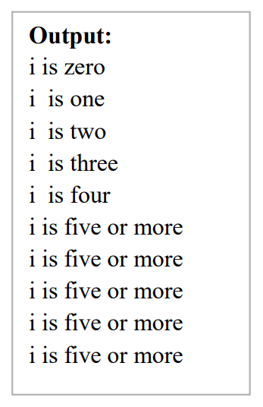
Program Control Statements
The Switch Statement: Example with break
for(int i=0; i< 10; i++) {
switch(i) {
case 0 : System.out.println(“i is zero”);
break;
case 4 : System.out.println(“i is four”);
break;
default: System.out.println(“i is five or more ”); } } } }

Slide 73
Program Control Statements
The Switch Statement: Example
Technically break statement is optional. When included within a case, it causes the program flow to exit from the entire switch statement and resume at the next statement outside the switch. However, if break is not present with a case, then all statements following the matching case will be executed until a break or end of switch is encountered.

Slide 74
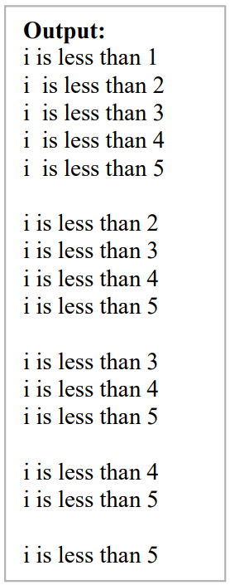
Program Control Statements
The Switch Statement: Example without break
class NoBreak {
public static void main(String args[]) {
for(int i=0; i<=5; i++) {
switch(i) {
case 0 : System.out.println(“i is less than 1”);
case 1 : System.out.println(“i is less than 2”);
case 4 : System.out.println(“i is less than 5”);} System.out.println(); } } }

Slide 75
Program Control Statements
The Switch Statement: Example without break
We can have empty cases as shown in the example below
switch(i) {
case 0 :
case 1 :
case 2 : System.out.println(“i is 0 1 or 2”);
break;
case 3 : System.out.println(“i is 3”);
}

Slide 76
For Loop
The general form of for loop for repeating a single statement is for(initialization; condition; iteration)
statement;

Slide 77
For Loop
The initialization is usually an assignment statement that sets the initial value of the loop control variable. The condition is a Boolean expression that determines whether or not the loop will repeat. The iteration expression defines the amount by which loop control variable will change each time the loop is repeated. These three sections must be separated by semicolons. The for loop will continue to execute as long as the condition evaluates to true. Once the condition becomes false, loop will be terminated and control will be transferred to the statement following for.

Slide 78
For Loop
Example: //Demonstration of for loop
class ForDemo {
public static void main(String args[]) {
int i;
for(i=0; i<5; i++)
System.out.println(i+“ ”);
}
}
Output: 0 1 2 3 4

Slide 79
For Loop
For loop can proceed in a positive or negative fashion.
Example: //Demonstration of for loop
class NegFor {
public static void main(String args[]) {
int i;
for(i=10; i>5; i--)
System.out.print(i+ “ ”);
}
} Output: 10 9 8 7 6

Slide 80
For Loop
In case of for loop, the condition always gets tested in the beginning. This means that, the code inside the loop may not be executed at all if the condition is false in the beginning.
Example:
for(count=10; count <5; count++)
x += count; // This statement will not get executed at all

Slide 81
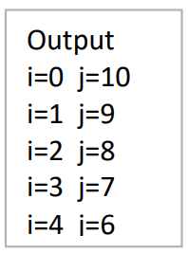
For Loop
We can use multiple loop control variables in a for loop. Here commas separate the two statements.
Example:
class MulFor {
public static void main(String args[]) {
int i,j;
for(i=0, j=10; i<j; i++, j--)
System.out.print(“i= ” +i +” j= ”+j);
}}

Slide 82
For Loop
Missing Pieces
In Java, it is possible for any or all of the initialization, condition or iteration portions of the for loop to be blank.
Example-1: //Demonstrate for loop with some empty parts
class Empty {
public static void main(String args[]) {
int i;
for(i=0; i<10; ) { // Iteration expression is missing here System.out.println(“Pass ”+i);
i++; }}}

Slide 83
For Loop
//Demonstrate for loop with some empty parts
class Empty2 {
public static void main(String args[]) {
int i=0;
for(; i<10; ) { // Initialization and iteration expressions are missing System.out.println(“Pass ”+i);
i++; }}}

Slide 84
For Loop
The Infinite Loop
An infinite loop can be created using for by leaving conditional expression empty. The structure of an infinite loop is as follows:
for(;;) // Intentionally infinite loop
{ ....... }
This loop will run for ever. Use of break statement inside such loop can terminate the loop.

Slide 85
For Loop
Loops with No Body
In Java, the body associated with a for loop can be empty.
//Demonstrate for loop with no body
class Empty3 {
public static void main(String args[]) {
int i, sum=0;
for(i=0; i<=10; sum+=i++);
System.out.println(“Sum = ”+sum);
}}

Slide 86
For Loop
Declaring Loop Control Variables Inside the for Loop Often the variable that controls a for loop is only needed for the purposes of the loop and is not used elsewhere. When this is the case, it is possible to declare the variable inside the initialization portion of the for loop.

Slide 87
For Loop
Example: // Declare a loop control variable inside the for.
class ForVar {
public static void main(String args[]) {
int sum=0,fact=1;
for(int i=1;i<=5;i++) // i is declared inside the loop
{ sum+=i;
fact*=i; // i is available only till here } System.out.println("Sum = " + sum); // i is not known to this part System.out.println("Factorial = " + fact); } }

Slide 88
For Loop
When a variable is declared inside a for loop, the scope of that variable ends when the for statement does. Outside the for loop, the variable will cease to exist. If the variable is to be used elsewhere in the program, it has to be declared outside the for loop.

Slide 89
While Loop
Syntax:
while(condition)
statement;
Where the statement may be a single statement or a block of statements. Condition is a valid Boolean expression that controls the loop. Loop repeats while the condition is true. When the condition becomes false, program control passes to the line immediately following the loop.

Slide 90
While Loop
Example: //Demonstration of while loop
class WhileDemo {
public static void main(String args[]) {
char ch= ‘a’;
while (ch<= ‘z’) {
System.out.print (ch + “ ”);
ch++;
}
}
}

Slide 91
do – while Loop
In do... while loop, condition is always tested at the bottom of the loop. This means that dowhile loop will always execute at least once. The general form of do-while is
do {
statements;
} while(condition);

Slide 92
do – while Loop
// Demonstrate the do-while loop
class DoWhileDemo {
public static void main(String args[])throws java.io.IOException { char ch;
do {
System.out.println(“Enter a character”);
ch=(char) System.in.read();
System.out.println(ch+” “);
} while (ch!=’q’); } }

Slide 93
Use of break to Exit a Loop
It is possible to force an intermediate exit from a loop, bypassing any remaining code in the body of the loop using break statement. When a break statement is encountered inside a loop, the loop is terminated and the program control resumes at the next statement following the loop.

Slide 94
Use of break to Exit a Loop
Example: //Using break to exit the loop
class BreakDemo {
public static void main(String args[]) {
int num=100;
for(int i=0;i<num;i++) {
if(i*i >= num)
break; // terminate loop if i*i >=100 System.out.println(i+" ");
}
}
}

Slide 95
Labelled break Statement (break as a form of goto)
In Java, we can give a label to a block of statements. A label is any valid Java variable name. Label is given to a loop by placing it before the loop with a colon at the end.
loop1:
for(…..........)
{ .....................;
break loop1;
}

Slide 96
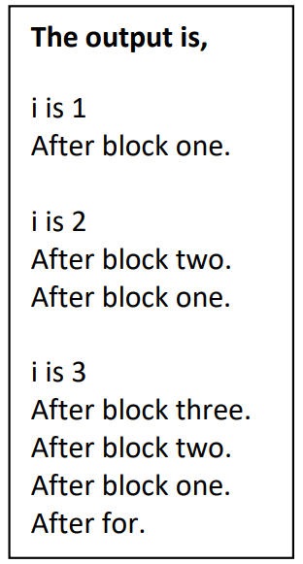
//using break with a label
class Break4 {
Public static void main(String args[]) {
int i;
for(i=1;i<4;i++) {
one: {
two: {
three: {
system.out.println(“\n i is “+i);
if(i==1) break one;
if(i==2) break two;
if(i==3) break three; // this is never reached System.out.println(“won’t print”); } System.out.println(“After block three.”); } System.out.println(“After block two.”); } System.out.println(“After block one.”); } System.out.println(“After for”); } }

Slide 97
The continue statement
The continue statement forces the next iteration of the loop to take place skipping any code between itself and the conditional expression that controls the loop. The following program uses continue to print even numbers from 1 to 100:

Slide 98
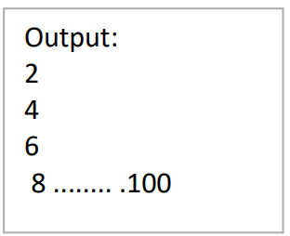
The continue statement
Example: //Use of continue
class contDemo {
public static void main(String args[]) {
for(int i=1;i<=100;i++) {
if((i%2)!=0)
continue;
System.out.println( i);
}
}
}

Slide 99
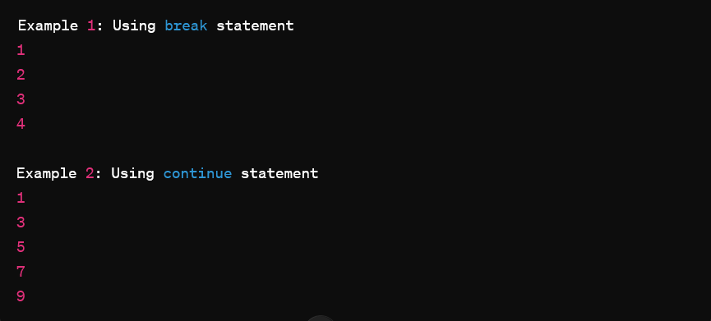
Use of break and continue statements
public class BreakContinueExample {
public static void main(String[] args) {
System.out.println("Example 1: Using break statement");
for (int i = 1; i <= 10; i++) {
if (i == 5)
break; // Exit the loop when i equals 5 System.out.println(i); } System.out.println("\nUsing continue statement"); for (int i = 1; i <= 10; i++) {
if (i % 2 == 0)
continue; // Skip the even numbers
System.out.println(i);
}
} }

Slide 100
Nested Loops
Writing one loop inside the scope of other loop is called nesting of loops. class Nest {
public static void main(String args[]) {
for(int i=2;i<=10;i++) {
System.out.print(“Factots of “ + i +”: ”);
for(int j=2; j<i;j++)
if(i%j==0)
System.out.print(j+ “ ”);
System.out.println();
} } }

Slide 101
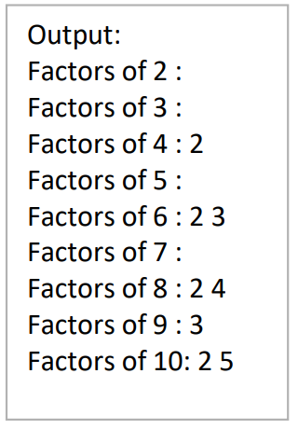
Nested Loops

